Slide 1
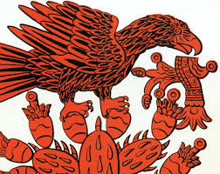
Discussion of Xicano/a Indigenous Identity
Affirmation
Alliances
Complexities
Contradictions

Slide 2
Discussion of Xicano/a Indigenous Identity
Introduction
Discussion goals, ideas, hopes, etc.
Key questions and contradictions within discussion -“Are we indigenous”? Who gets to say?
How do we define “indigenous” or “indigeneity” again who gets to say?
The complexities of Xicanomexica Indigenous identity

Slide 3
Discussion of Xicano/a Indigenous Identity
Is the “mestizaje” philosophy out dated?
What are we saying when we say we are “mestizos”?
Is the Mestizo idea utilized to erase the present day indigenous (idealize the Indian past but degrade the Indian present)
Can the mestizaje concept be re conceptualized for decolonization?

Slide 4
Discussion of Xicano/a Indigenous Identity
Is the mestizo idea fundamentally grounded in colonialism and racism?
How do we correctly identify and reclaim lo indigena in nuestra cultura ( “ Mexican ways are Indian ways”)
Medicinal knowledge,
Culinary traditions (food is culture),
syncretism of religion and spirituality, cosmovision.

Slide 5
Discussion of Xicano/a Indigenous Identity
language syncretism (aztequismos and other manifestations)
Creation of alliances and community with northern relatives
Creation of alliances and community with southern relatives

Slide 6
Discussion of Xicano/a Indigenous Identity
How do we work to create the “Mexico Profundo” in Mexico proper?
With purpose reinvigorate the remnants and reclaim the lost
Finally, why is it important to reclaim and relearn and live from an indigenous worldview?

Slide 7
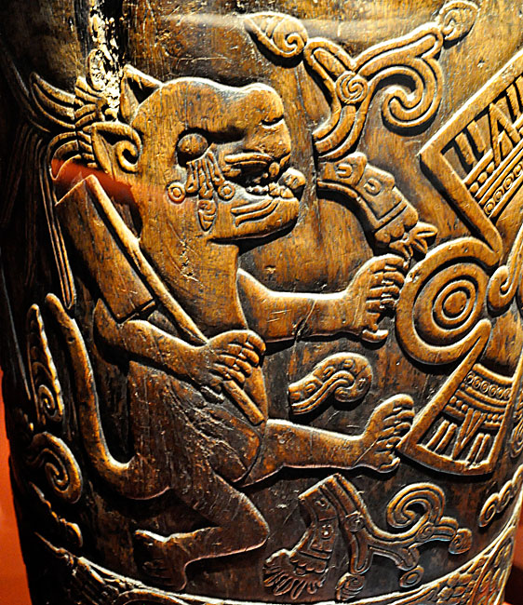
Discussion and Affirmation of Indigenous Identity

Slide 8
Discussion and Affirmation of Indigenous Identity
KEY QUESTIONS –
What does it mean when we say we are a indigenous people ?
What is indigeneity?
Is our only claim to being indigenous our racial/ancestral heritage (blood line, blood quantum)
IF NOT

Slide 9
Discussion and Affirmation of Indigenous Identity
What are the other factors of our indigenous identity ?

Slide 10
Discussion and Affirmation of Indigenous Identity
Obvious ancestral and racial heritage
Cultural heritage
Culinary “corn tortilla, bean and chile millennial breakfast”
Linguistic remnants / heritage speakers

Slide 12
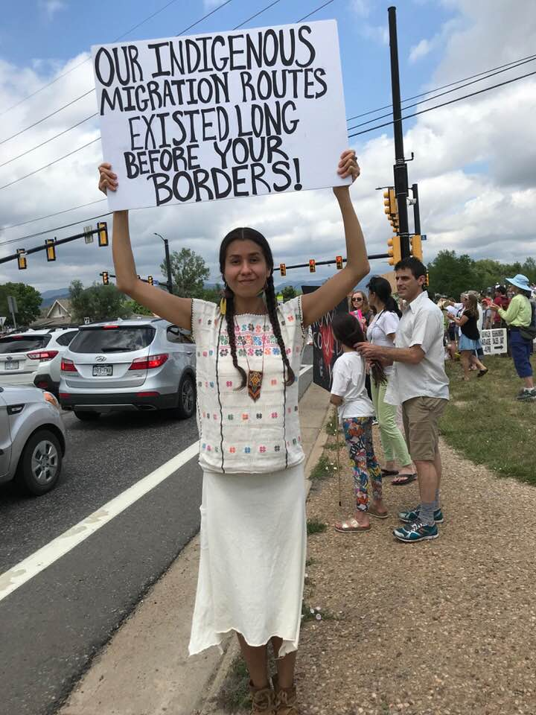
Discussion and Affirmation of Indigenous Identity
Pre invasion history/ north to south migration and trade/
south to north migration and trade/ Maiz culture
European existence in Americas at 526 years
History of the native people of Americas at least 14,000 to 20,000 years.
If the human existence in the Americas were a 24 hour period the European presence would be around 30 minutes.

Slide 13
Discussion and Affirmation of Indigenous Identity
To begin our history with the European invasion is incorrect, ahistorical, and an insult to our ancestors.
Placing our origin history in its proper context makes us aware of the insidious attempt of colonial miseducation to erase our history.

Slide 15
Discussion and Affirmation of Indigenous Identity
How do we consciously, respectfully and with purpose reaffirm our indigenous self?

Slide 16
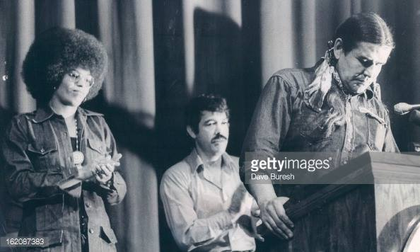
Discussion and Alliances with other Native nations and peoples

Slide 17
Discussion and Alliances with other Native nations and peoples
In recent history many examples of Native American and Xicana/o alliances and community building
La Alianza and Reis Lopez Tijerina placed focus on the issue of lost land, develop dialogue between native nations and chicanos.
Utilized the term Indo hispano.
Crusade for Justice and alliance with Denver AIM and National AIM

Slide 18
Discussion and Alliances with other Native nations and peoples
Chicanos present at the Wounded Knee in 1973
Chicanos gave material support to Wounded Knee participants
Tony Gonzalez and the background of the International Indian Treaty Council,
IITC supporting chicanos as indian people and right to self determination

Slide 19
Discussion and Alliances with other Native nations and peoples
Formation of the Treaty of Guadalupe Project
National Chicano Human Rights Council
Many organizations organized around chicano indigenous identity
Tonatierra in Arizona
Peace and Dignity runs
Danza Mexicayotl
Native American Church

Slide 20
Discussion and Alliances with other Native nations and peoples
More Recent examples of Xicano native nation alliances and solidarity
Participation at DAPL
Other examples of current alliance and community building amongst Xicano and native nations.

Slide 21
Discussion and Alliances with other Native nations and peoples
Examples of non political alliance and community?
The long interconnectedness of the communities in the Americas and the specifically in the southwest.
The stories that aren’t told in academic journals. How do we begin to tell those stories? Should we begin to tell those stories ?

Slide 22
Discussion and Alliances with other Native nations and peoples
What are some of the barriers to xicano and native recognition and alliance building ?
What are some of the criticisms of Xicanos claiming an indigenous identity?- “ indigenous descended but you’re not indigenous”
Were mexicanos complicit in the settler colonial project?
Both colonized and collaborators in settler colonialism?

Slide 23
Discussion and Alliances with other Native nations and peoples
If true how or does that negate or cancel our indigenous identity
Are we settlers of color not an indigenous people?
How do we address these criticisms ?
What should be the ultimate goal?

Slide 24
Discussion and Alliances with other Native nations and peoples
Alliances with specific native peoples that may face the same challenges as the Xicano people in assertion of native identity
The Metis people of Canada ( The dream of Louis Riel)
The Genizaros of New Mexico
Study the challenges of the other groups where colonialism has pitted supposed indigenous against supposed “mixed bloods”
South Africa the “coloureds” “lets untie the knots”

Slide 25
