Slide 1
“It is with the intention of making a contribution, however modest, to this debate that we present here our opinion of the foundations and objectives of national liberation in relation to the social structure. This opinion is the result of our own experiences of the struggle and of a critical appreciation of the experiences of others. To those who see in it a theoretical character, we would recall that every practice produces a theory, and that if it is true that a revolution can fail even though it be based on perfectly conceived theories, nobody has yet made a successful revolution without a revolutionary theory.”
Notes:
Cabral, Amilcar. “The Weapon of Theory” The Journal of Pan African Studies, vol.3, no.5, e-Document, December 2009
Cabral’s address at the Tricontinental Conference in Cuba 1966.

Slide 2
Organizing
Building a national Xicana/o Identity
Preserving Xicana/o History and restoring a collective memory
Creating a Xicana/o narrative for activism and political action
Assembling data on Mexican-American activism nationwide
How not to reinvent the wheel.

Slide 3
Change Statement
Who | Will Change What | From What | To What | When | Why
Organizers at the Aztlan Center | The theory and practice of Xicana/o community organizing | A deficit model of organizing that addresses inequality solely from a reform and inclusion paradigm | To a pro-nationalist liberation model operating with indigenous philosophy and common vocabulary | During the Aztlan Center Community Organizing Seminars | A growing awareness of Xicana/os as indigenous and the deeply structured legal attack on the Xicana/o community

Slide 4
One Approach
Centralized policy or mission.
A network of organizers who understand the implications of nation building.
Facilitating Leadership through education.
Build online trainings to begin.

Slide 5
Demographics for the next 50 years

Slide 6
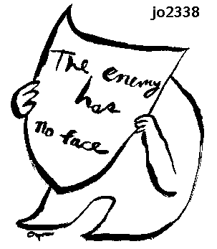
Mega-trends of the future.
Population growth
Urbanization
Littoralization
Connectedness
The mega trends of population growth, urbanization, littoralization and connectedness suggest that conflict is increasingly likely to occur in coastal cities, in underdeveloped regions of the middle East, Africa, Latin America, and Asia, and in highly networked, connected settings. We’re still likely to experience wars between nation-state, and conflict in remote areas such as mountain jungles, and deserts wills till undoubtedly occur. But the trends are clear: more people than ever before in history will be competing for scarcer and scarcer resources in poorly governed areas that lack adequate infrastructure, and these areas will be more and more closely connected to the global system, so that local conflict will have far wider effects.
- David Kilcullen, “Out of the Mountains: the coming age of the urban guerilla”, 2014.

Slide 7
The will to organize
What is a Xicano organizing paradigm?

Slide 8
What is the purpose of Low Intensity Organizing?
Train organizers to work in the community
Politically educate the Xicano/Indigenous community
Provide a vehicle for the political expression of the
Xicano/Indigenous communities
Help communities garner the ability to answer back some of the more serious attacks i.e. immigration, school reform, imprisonment of our youth.
Organize a political machine on a broad front that will work to teach advocacy and self reliance through education and the creation of national policy that strengthens the Xicano/Indigenous community.

Slide 9
Decolonize does not = national liberation
“On the basis of this, we can state that national liberation is the phenomenon in which a given socio-economic whole rejects the negation of its historical process. In other words, the national liberation of a people is the regaining of the historical personality of that people, its return to history through the destruction of the imperialist domination to which it was subjected.”
Notes:
Cabral, Amilcar. “The Weapon of Theory” The Journal of Pan African Studies, vol.3, no.5, e-Document, December 2009
Cabral’s address at the Tricontinental Conference in Cuba 1966.

Slide 10
Where we begin

Slide 11
Basic structure
Divide country into regions.
Initially develop one contact per region
Work for one contact per state
Begin to build education/organizing committees in respective communities.
These committees feed information into the think tank.
The question is not can we build this network, but what are we going to do with it once it’s built.

Slide 12
Deficit model: The "deficit" model focuses on the student as the major problem, neither looking within the environment nor the instructional practices in the classroom. According to this model, the typical response--once the teacher requested assistance by completing a referral form and turning it into the designated person--was to test the student, determine eligibility for special education and then remove the student from the environment (s) where the problem existed. After more than two decades of federal legislation and implementation of the "deficit" model, there are now mounting concerns about the outcomes of students who have been served in this manner. Despite years of mandated services, many students with mild to moderate disabilities continue to "fall through the cracks."
How do we define organizing?
What are the different frameworks for organizing?
Lets rewrite the above definition to explain the deficit organizing model.

Slide 13
Indigenous Epistemology The Four Teachings
The foundation of the tremendous change we have seen in Xicano Studies Paradigm center on the return of the 4 Tezcatlipoca to Xicano Meso-American epistemology.

Slide 14
Indigenous Epistemology - Tezcatlipoca
Reflection
Tezcal = Mirror
Popoca = Smoke
Tezcatl + Popoca = Smoking Mirror
Yayauhqui Tezcatlipoca
Sun of JAGUAR
Element of EARTH
The direction of NORTH – MICTLAMPA
A concept meaning memory as well as introspection and reflection.

Slide 15
TEZCATLIPOKA
Tezkatlipoka-self-reflection. Literally translated Tezkatlipoka means "the smoking mirror" and is a concept meaning memory as well as self-reflection. This represents the active journey to find our inner self. As when looking in a bathroom mirror covered in condensation, we must vigorously search for ourselves through the distractions and obstacles in our lives.

Slide 16
Indigenous Epistemology - Quetzalcoatl
Knowledge/Wisdom
Quetzal – Precious/Beautiful
Coatl = Serpent (symbol knowledge)
Quetzal +Coatl = Precious/Beautiful Knowledge
Iztac Tezcatlipoca
Sun of WIND
Element of AIR
The direction of WEST- CIHUATLAMPA
A concept meaning precious knowledge. A title given to those who achieve the highest understanding of righteousness and humility.

Slide 17
QUETZALKOATL
Quetzalkoatl-precious and beautiful knowledge. Learning about our history follows self-reflection. Gaining perspective on events and experiences that our ancestors endured allows us to become more fully realized human beings. As Marcus Garvey said, "A people without the knowledge of their past history, origin and culture is like a tree without roots.

Slide 18
Indigenous Epistemology - Huitzilopochtli
OUR WILL
Huitzilin = Hummingbird
Opochitli = Left
Huitzilin + Opochitli = Humming bird to the left
Texouhqui Tezcatlipoca
Sun of RAIN and FIRE
Element of FIRE
The direction of SOUTH - HUITZLAMPA
A concept meaning the will of the person or people to be positive, progressive and creative.

Slide 19
HUITZILOPOCHTLI
Huitzilopochtli-the will to act. Huitzilopochtli literally translates as "hummingbird to the left." This is in reference to the heart being on the left side of the body and the hummingbird's tenacity of work rate to fly and the strength of its will. It is also symbolic of the sun rising in the wintertime. This concept has meaning for the will of a person or people to be positive, progressive, and creative.

Slide 20
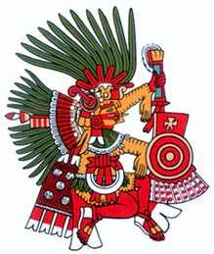
Indigenous Epistemology - Xipe Totec
Transformation
Xipe = Shedding of Skin
To = Our
Tec = Guide
Xipe + To + Tec = Our Guide of shedding and transformation.
Tlatlauhqui Tezcatlipoca
Sun of WATER
Element of WATER
The direction of EAST – TLAHUIZTLAMPA
A concept of meaning shedding of the old, leaving behind that which hinders us. An acceptance of the new, embracing and utilizing that which evolves us and prepares us for progress.

Slide 21
XIPE TOTEK
Xipe Totek-transformation. Identified as our source of strength that allows us to transform and renew. We can achieve this transformation only when we have learned to have trust in ourselves.

Slide 22
How do we move from deficit model of organizing
4 Tezcatlipoca’s – Why don’t these concepts create a deficit.
Based on our model of deficit organizing what can we expect from the communities we work with?
What type of scenario is set up by the idea there is no end that you can reach in terms of development.
Why might recognizing development rather than deficiencies be preferable in developing leadership?
Medical Model – We diagnose the problem then ‘fix’ it.

Slide 23
The training program

Slide 24
We don’t need to train organizers
Midwest Academy: Organizing for Social Change
Dolores Huerta Foundation
Industrial Areas Foundation
Highlander Center
Service Employees International Union - Organizer in Training
Just to name a few...
Notes:
Trying to build structures for Xicanos that teach organizing skills is not really necessary. What is necessary is a thorough understanding of decolonization within the context of a national liberation movement. What is a national liberation movement? Like Cabral said in the opening quote “every practice produces a theory’ what is the theory of xicano organizing?

Slide 25
Identifying organizers
Survey of hot spots around the country. Where are Xicana/os moving socially, politically and culturally?
Reach out to specific organizers with materials (i.e. The Blueprint, Think Tank and national organizing plan) set up face to face meetings with them.
Recruit them as on the ground organizers for that region.

Slide 26
How it works
Two basic entry points for the organizing:
Direct training through a four day seminar.
Training through ongoing local committee work
Since there are many organizations across the country that provide organizer training it seems important for us to focus more on the organizational and building aspect.

Slide 27
Current situation - broadly
No lack of social, cultural and political activity across the country.
Lots of successful and unsuccessful organizing projects,
No national coordination.
No articulated Xicana/o analysis of power or the state outside of a basic decolonial ideal.
Notes:
Pablo Gonzalez Casanova started to do this with the internal colonialism.
“Internal Colonialism is an integral phenomenon (Gonzalez Casanova, 2002 : 86) that highlights the singularity of peripheral national power in colonization. Here, economic and speculative capitalism logic fits the patrimonial and oligarchic domination generating new narratives and modes of appropriation of local richesses. But, nowadays, the inter-ethnic tensions between colonizing and colonized are no longer limited to the former territories of colonization. They move to the central capitalist societies. The complexity of motivations and demands produced by coloniality threaten the values of equality and freedom that have referenced the liberal democratic revolutions in central countries. The traditional division of classes are over-determined by a moral division generated by inter-ethnic and inter-national colonial tensions.” http://www.journaldumauss.net/?Internal-Colonialism-Postcolonial-Criticism-and-Social-Theory
Decolonization is not a theory of the state in it current form because everything is decolonization which is clearly not the case.

Slide 28
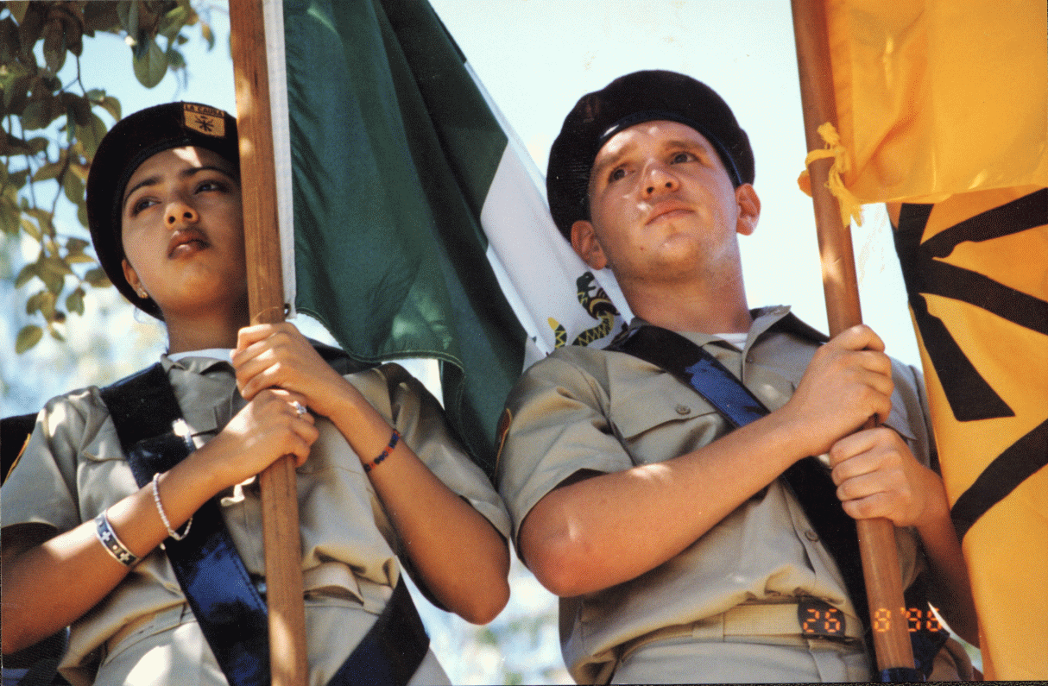
We need a program
We need a program

Slide 29
Low Intensity Organizing
Low Intensity Organizing focuses on long-term change. - Change does not happen overnight. The ability to confront entrenched beliefs and attitudes takes long-term education and political mobilization.
Low Intensity Organizing rejects single issue organizing.- Single issue organizing can be effective in terms of addressing a problem i.e. traffic lights, union drive or an electoral campaign what inevitably happens is the buildup of energy is dissipated until the next official round.
Low Intensity Organizing is educational.- LIO develops long-term educational programs within communities that focus on strategies for challenging apathy and creating popular education campaigns. Education produces effective analysis and critique after prolonged discussion and political activity.
Low Intensity Organizing builds community. - LIO builds community through the production of theoretical knowledge and its application by instigating ideological conflict instead of compromise
Low Intensity Organizing builds dual power. - Building effective and lasting institutions is important in any struggle for national liberation.
Notes:
Shultz, Richard H. “The Low-Intensity conflict environment of the 1990s” Annals of the American Academy of Political and Social Science, Vol. 517 New directions in Defense Policy. (Sep. 1991), pp. 120-134.

Slide 30
Our issue is building a sustainable Xicano nation in the 21st century
The original goal of the organizing program was to create four, four day training seminars. Each one focusing on an aspect of the Nahui Ollin (Tezcatlipoca, Quetzalcoatl, Huitzilopochtli, and Xipe Totec.) This way we would begin to associate these energies with certain aspects of our organizing work.
By definition nation is the largest grouping that commands loyalty. Nation is not, nor could it ever be, a single issue.
Notes:
What does political mobilization mean? First, it means telling the army and the people about the political aim of the war. It is necessary for every soldier and civilian to see why the war must be fought and how it concerns him….Secondly, it is not enough merely to explain the aim to them; the steps and policies for its attainment must also be given, that is, there must be a political program…Thirdly, how should we mobilize them? By word of mouth, by leaflets and bulletins, by newspaper, books and pamphlets, through plays and films, through schools, through the mass organizations and through our cadres. Fourthly, to mobilize once is not enough; political mobilization for the War of Resistance must be continuous movement. Our job is not to recite our political program to the people, for nobody will listen to such recitations; we must link the political mobilization for the war with developments in the war and with the life of the soldiers and the people, and make it a continuous movement. This is a matter of immense importance on which our victory in the war primarily depends. -Mao

Slide 31
Building power and organization within communities is an intentional act.
Using Indigenous philosophies, as a training framework for Xicana/o organizers was appealing and the challenge of then developing indigenous epistemologies like the Nahui Ollin, Panche Ve, and In Lak Ech into successful community campaign frames was intriguing.
‘This is close to Clausewitz, who, in Book 4 ('The Engagement'), identified 'fighting' as the 'essential military activity. . . which by its material and psychological effect comprises in simple or compound form the overall object of the war'. But he did not present war as an autonomous act or as a uniform phenomena: 'the probable character and general shape of any war should mainly be assessed in the light of political factors and conditions'. The logical conclusion he drew was that political policy-makers should be the final controlling authority in war.’
Notes:
Adams, Thomas K. (1990) 'LIC (low-intensity Clausewitz)', Small Wars & Insurgencies, 1:3, 266 - 275

Slide 32
Space + Time = Will

Slide 33
Space + Time = Will
Mao’s military problem was how to organize space so that it could be made to yield time. His political problem was how to organize time so that it could be made to yield will, that quality which makes willingness to sacrifice the order of the day … Mao’s real military problem was not that of getting the war over with, the question to which Western military thinkers have directed the greater part of their attention, but that of keeping it going.
Katzenbach, E. L. Jr. “Time, Space and Will: The politico-military views of Mao Tse Tung,” in the “The Guerilla and how to fight him”. Edited by Col. T. N. Greene; Frederick A. Praeger, pg. 13

Slide 34
Sample Bibliography
Whither Anarchism? By Kristian Williams
“The Coming Insurrection” by The Invisible Committee
E.L. Katzenbach. “Space + Time = Will: The political theories of Mao Tse Tung” (The Guerilla and How to Fight Him pdf)
Asad Haider, “Mistaken Identity: Race and Class in the age of Trump.”
Amilcar Cabral. “The Weapon of Theory” The Journal of Pan African Studies, vol.3, no.5, e-Document, December 2009
Frantz Fanon. Wretched of the Earth
Mao Tse Tung - Selected Readings (On Protracted Warfare, On Practice, On Theory)
David Kilcullen. “Out of the Mountains: the coming age of the urban guerilla”, 2014.
T.X. Hammes. “Fourth Generation Warfare Evolves, Fifth Emerges” Military Review, May-June 2007.
Gene Sharp. Self Liberation a guide to strategic planning for action to end a dictatorship and other oppressions
Gene Sharp. From Dictatorship to Democracy a conceptual framework for liberation.

